Slide 1
QDM-Based Logic (Bonnie-prior, v1.6.11)
CMS32v7

Slide 2
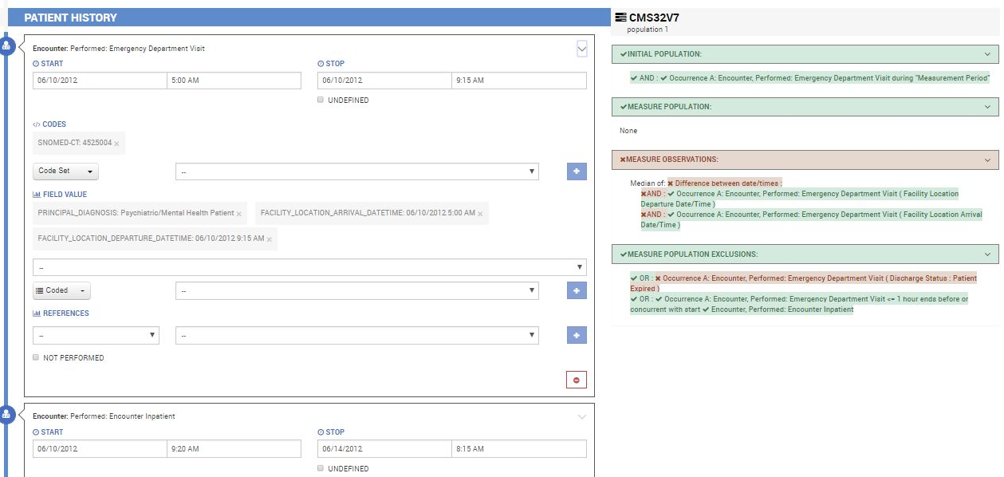

Slide 3
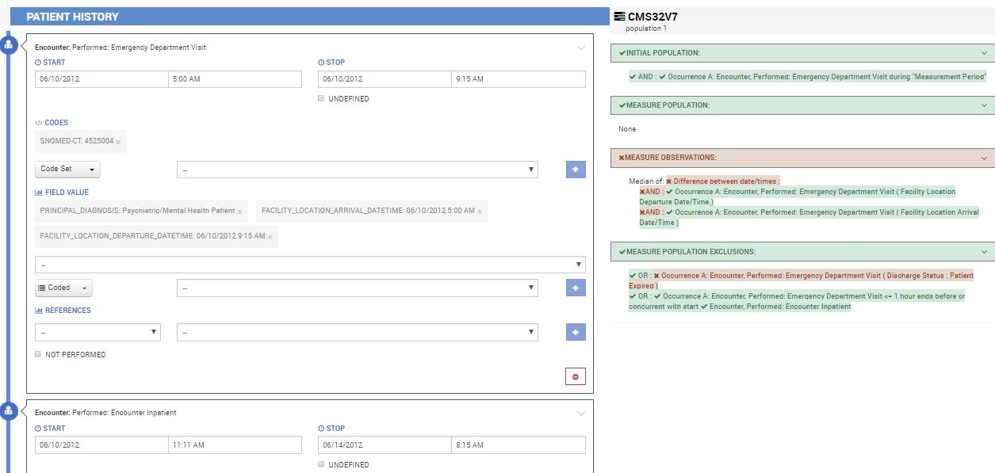

Slide 4
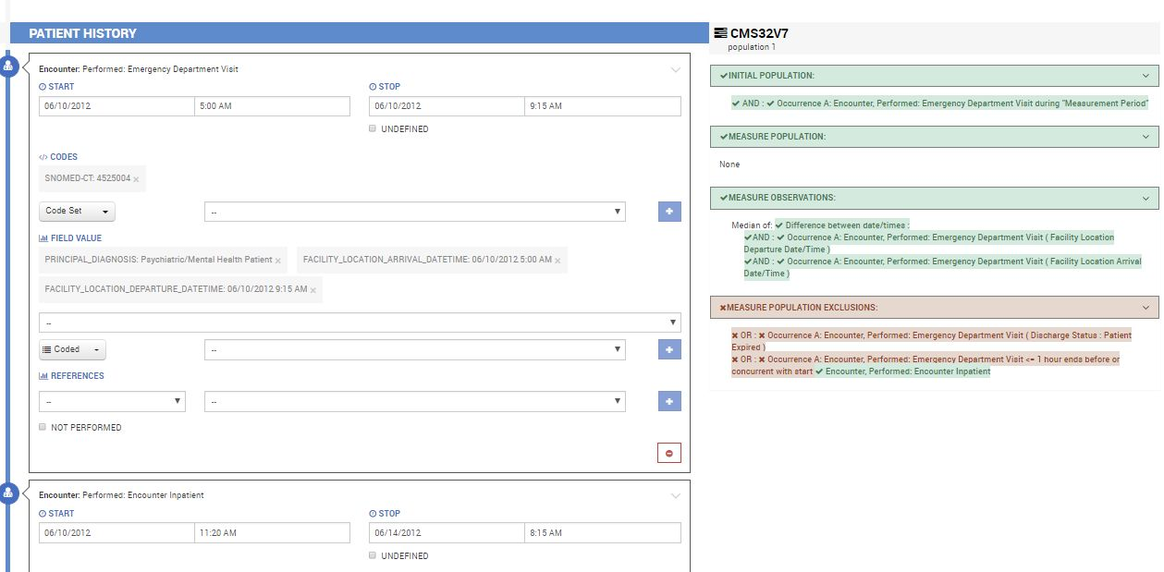

Slide 5
CQL-Based Logic (Bonnie, v2.0.7)
CMS32v8

Slide 6
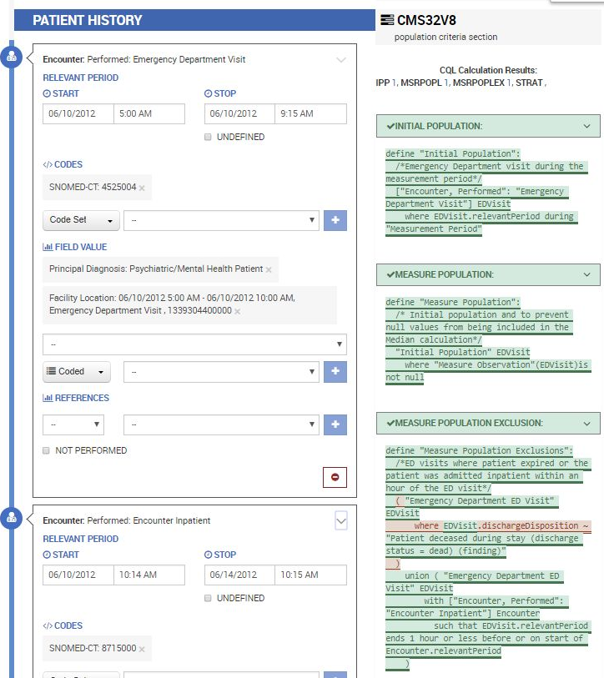

Slide 7
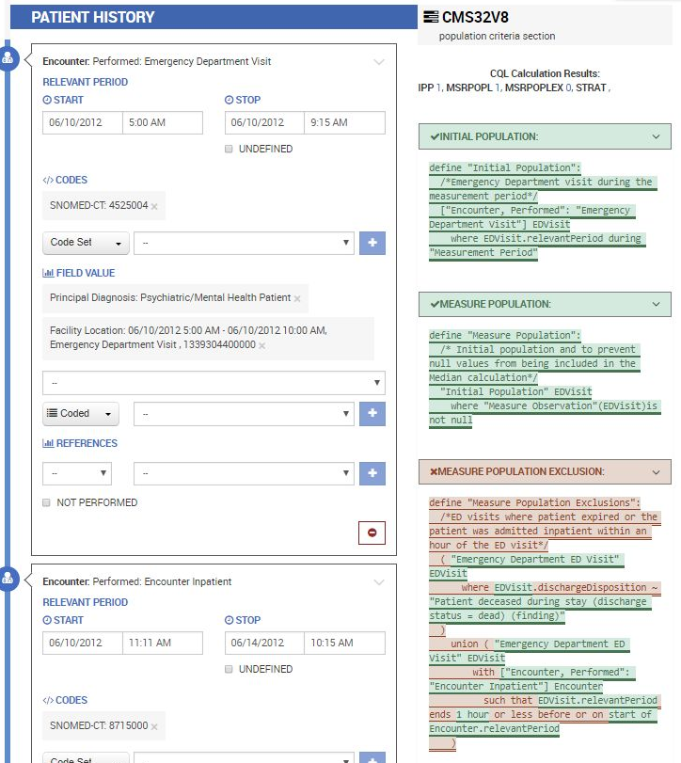
With QDM-Logic (CMS32v7),
This was all green (excluded)
With CQL-Logic (CMS32v8),
Not all green (not excluded)

Slide 8


Slide 9


